Slide 1



Ipsos quality awards 2018
Ipsos 2017 Competitive Customer Experience survey results
1
© 2018 Ipsos.

Slide 2
CONTENT
01
BACKGROUND
02
ABOUT THE RESEARCH
03
HEADLINE RESULTS
04
DEMOGRAPHICS
05
IPSOS QUALITY AWARDS 2016
2
© 2018 Ipsos.

Slide 3
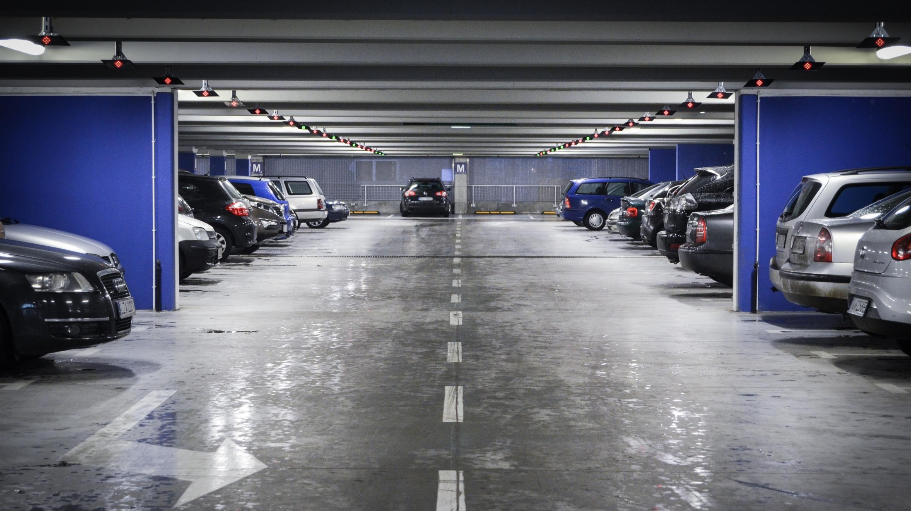
BACKGROUND
3
© 2018 Ipsos.

Slide 4
IPSOS AND THE AUTOMOTIVE INDUSTRY
1991
2001
2004
2012
IPSOS
Commissioned to conduct market research on behalf of the South African Automotive industry since 1991
  SUPPLY CUSTOMER NAMES FOR INTERVIEWING
  The research follows a syndicated format with various Original Equipment Manufacturers contributing ideas and funding. Any OEM can participate if they:
  Agree to the rules of syndication
  Participate in meetings / decisions regarding syndicate business in a transparent and open manner

Slide 5















CCE Representation
Background
PARTICIPATING CCE BRANDS
  Any OEM can participate if they:
  Supply customer names for interviewing
  Agree to the rules of syndication
  Participate in meetings / decisions regarding syndicate business in an open and transparent manner
CCE COVERAGE
REPRESENTED
NOT REPRESENTED
Ipsos interviewed more than 20 000 customers about their purchasing and servicing experience in 2016
  The sales volume of the participating brands represented more than 3 out of 4 of every new vehicle sold via the Dealership channel in South Africa during 2017
5
© 2018 Ipsos.

Slide 6
MEASURING THE OWNERSHIP EXPERIENCE
PURCHASE
Customer purchases a new vehicle from dealership
DRIVE
Customer drives vehicle for 3 months
SERVICE
Customer has vehicle serviced at dealership
CCE SALES
CCE Sales interview 10 – 35 days after event
VQS
VQS interview ~90 days in service
CCE SERVICE
CCE Service interview 10 – 35 days after event
Ownership Experience

Slide 7

About the research
7
© 2018 Ipsos.

Slide 8
Process
About the research
Vehicle purchased / serviced
Customer data submitted to Ipsos
Customer rates experience
Reporting issued to manufacturer
1
2
3
4
5
6
7
8
Customer details captured
Ipsos contacts customer
Feedback extracted and analysed
Improvement strategies identified

Slide 9
CCE FAQs
About the research
WHO DO WE SPEAK TO?
New vehicle owners and owners who have just had their vehicle serviced – within 35 days
WHERE DO WE GET THE NAMES FROM?
Supplied by OEMs, quality checked and submitted to CATI team
HOW DO WE
INTERVIEW THEM?
Telephonically using CATI
WHAT QUALITY ASSURANCE IS THERE?
Four quality gates are in place. ISO 20252 and ISO 9001 : 2008 compliant

Slide 10
Quality Gates
About the research
MANUFACTURER
IPSOS
FIELDWORK
GATE 1
Format – Electronic data source (Warranty System, OEM Sales database)
GATE 2
Pre-Quantity – Volume of records received, compared to NAAMSA reported dealer sales may not vary by more than 10%
GATE 3
  Pre-Quality – Record must contain each of the following:
  Individual’s surname
  a valid contact number (mobile or landline)
  a valid OEM model description
GATE 4
Post Quality – Deemed to be errors in data:
No such person
Do not own vehicle
Wrong number

Slide 11
Respondent Selection
About the research
Interviews only completed if the following is confirmed at the start of the interview:
  Customer identity
Random selection of respondents via an automated algorithm built into the CATI system.
All interviews are recorded.
  Transaction Date
  Dealership name
  Personal involvement in the entire Purchasing / Servicing process
  Not employed by a motor manufacturer or any of their dealers
11
© 2018 Ipsos.

Slide 12
About the research: THE INTERVIEW
*Sales **Service
01 INTRO AND SCREENERS
Introduction
Language
Transaction date / dealership / model
Bias
Personal involvement
Confirmation of delivery*
Bought NEW*
Vehicle age**
Service booking**
Waited at dealership**
02 RATIONAL
Overall Experience
03 BEHAVIORAL
Recommendation
04 EMOTIONAL
Appreciated as Customer
05 RELATIONSHIP
Advice you can trust
Making you feel important
06 COMPLIANCE: PURCHASING
Contact about progress
Ownership of queries / problems
Effort to understand needs
Contact after delivery
Exciting handover*
Understood cost of ownership*
Explanation of features / requirements*
Delivered as per specification*
Keeping promises*
Free of faults*
Vehicle that suits budget*
07 COMPLIANCE: SERVICING
Contact about progress
Ownership of queries / problems
Effort to understand needs
Contact after delivery
Prepared staff**
Trust that vehicle will be taken care of**
Transport to next destination**
Fixed-right-first-time**
Ready on time**
Explanation of work & invoice**
Cleanliness of vehicle**
08 DEMOGRAPHICS
Age
Race
Gender

Slide 13




analysis
BEHAVIOURAL
An Index Score is derived as an average of all attribute ratings*
Brands are grouped into ‘tiers’ based on statistically significant differences in scores**
Quality Awards are only presented to brands within the top three ‘tiers’:
Gold, Silver, Bronze
EMOTIONAL
RELATIONSHIP
COMPLIANCE
*Each rating has an associated score from 0% - 100% in equal increments according to the rating.
**Using confidence intervals calculated on a 95% confidence level. Results are weighted based on market share

Slide 14

Headline results
14
© 2018 Ipsos.

Slide 15
Purchasing Experience over Time
Headline results

Slide 16
Purchasing Experience: Passenger
Headline results

Slide 17
Purchasing Changes: Passenger
Headline results

Slide 18
Purchasing Experience: Light Commercial
Headline results

Slide 19
Purchasing Changes: Light Commercial
Headline results

Slide 20
Purchasing Attributes
Headline results

Slide 21
Servicing Experience over Time
Headline results

Slide 22
Servicing Experience: Passenger
Headline results

Slide 23
Servicing Changes: Passenger
Headline results

Slide 24
Servicing Experience: Light Commercial
Headline results
Mean (%)

Slide 25
Servicing Changes: Light Commercial
Headline results

Slide 26
Servicing Attributes
Headline results

Slide 27

demographics
27
© 2018 Ipsos.

Slide 28
Sales Index per Gender
DEMOGRAPHICS
PASSENGER DISTRIBUTION
FEMALE
MALE
40.6%
n = 2 536
59.4%
n = 3 222
LIGHT COMMERCIAL DISTRIBUTION
FEMALE
MALE
15.3%
n = 505
84.7%
n = 2 672
28
© 2018 Ipsos.

Slide 29
Sales Index per Age Group
DEMOGRAPHICS
PASSENGER DISTRIBUTION
LIGHT COMMERCIAL DISTRIBUTION
29
© 2018 Ipsos.

Slide 30
Sales Index per Race
DEMOGRAPHICS
PASSENGER DISTRIBUTION
LIGHT COMMERCIAL DISTRIBUTION
30
© 2018 Ipsos.

Slide 31
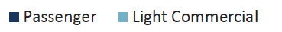
Sales Index per Province
DEMOGRAPHICS
PASSENGER DISTRIBUTION
LIGHT COMMERCIAL DISTRIBUTION
31
© 2018 Ipsos.

Slide 32
Service Index per Gender
DEMOGRAPHICS
PASSENGER DISTRIBUTION
FEMALE
MALE
32.6%
n = 2 700
67.4%
n = 5 397
LIGHT COMMERCIAL DISTRIBUTION
FEMALE
MALE
9.2%
n = 334
90.8%
n = 3 304
32
© 2018 Ipsos.

Slide 33
Service Index per Age Group
DEMOGRAPHICS
PASSENGER DISTRIBUTION
LIGHT COMMERCIAL DISTRIBUTION
33
© 2018 Ipsos.

Slide 34
Service Index per Race
DEMOGRAPHICS
PASSENGER DISTRIBUTION
LIGHT COMMERCIAL DISTRIBUTION
34
© 2018 Ipsos.
*Caution: Small Base Size.
Please exercise extreme caution when interpreting results

Slide 35
Service Index per Province
DEMOGRAPHICS
PASSENGER DISTRIBUTION
LIGHT COMMERCIAL DISTRIBUTION
35
© 2018 Ipsos.

Slide 36
Ipsos quality awards 2018
Official Ipsos 2017 Competitive Customer Experience survey results
36
© 2018 Ipsos.

Slide 37




Categories
About the REWARDS
IPSOS QUALITY AWARDS
(PURCHASING AND SERVICING 2018)
PURCHASING EXPERIENCE
Passenger vehicle purchasing experience
Light commercial vehicle purchasing experience
SERVICING EXPERIENCE
Passenger vehicle servicing experience
Light commercial vehicle servicing experience
1.
HIGHEST RANKED:
Ipsos Gold
2.
SECOND POSITION:
Ipsos Silver
3.
THIRD POSITION:
Ipsos Bronze
All results based on transactions between Jan and Dec 2017c

Slide 38
Ranking explanation
About the awards
STATISTICAL PRECISION AND ACCURACY WORKS IN A SIMILAR WAY:
The differences between certain scores may be statistically too small within the range of statistical tolerance to establish with certainty which performance is actually better
WHICH SHOT IS BETTER?
The difference between them is too marginal to assess and so they are all deemed to be winning shots

Slide 39

Purchasing experience
Ipsos Quality Awards 2017
39
© 2018 Ipsos.

Slide 40
Purchasing Experience
Ipsos Quality Awards 2018
PASSENGER VEHICLES
LIGHT COMMERCIAL VEHICLES
Audi
Nissan
Volkswagen
Nissan
Toyota
Volkswagen
95.7 - 97.3
93.8 - 95.8
Chevrolet
Mercedes-Benz
Opel
Toyota
Volvo
Chevrolet
Ford
Isuzu
93.0 - 95.6
≤ 91.3
Ford
Honda
Renault
≤ 92.9
40
© 2018 Ipsos.

Slide 41
Passenger Sales Rankings over Time
Purchasing Experience
JAN – DEC 2014
JAN – DEC 2015
JAN – DEC 2016
JAN – DEC 2017
Audi
Volkswagen
Audi
Volkswagen
Audi
Volkswagen
Audi
Nissan
Volkswagen
96.1 – 97.3
95.5 – 97.1
96.1 - 97.3
95.7 - 97.3
BMW
Chevrolet
Nissan
Opel
Toyota
Chevrolet
Mercedes-Benz
Nissan
Opel
Toyota
Chevrolet
Mercedes-Benz
Nissan
Opel
Toyota
Volvo
Chevrolet
Mercedes-Benz
Opel
Toyota
Volvo
93.9 – 96.0
93.8 – 95.4
93.5 - 96.0
93.0 - 95.6
Ford
Lexus
Mercedes-Benz
Renault
Volvo
Ford
Honda
Lexus
Renault
Ford
Honda
Renault
Ford
Honda
Renault
91.0 – 93.8
91.5 – 93.7
≤ 93.4
≤ 92.9
Please note:
Lexus and Peugeot have been excluded from the Jan - Dec 2017 PC Sales rankings due to low Sample Achieved / high Margin of Error considerations.

Slide 42
Light Commercial Sales Rankings over Time
Purchasing Experience
JAN – DEC 2014
JAN – DEC 2015
JAN – DEC 2016
JAN – DEC 2017
Isuzu
Volkswagen
Isuzu
Nissan
Toyota
Volkswagen
Chevrolet
Isuzu
Nissan
Toyota
Volkswagen
Nissan
Toyota
Volkswagen
93.1 – 95.5
92.9 – 95.1
91.4 - 95.7
93.8 - 95.8
Chevrolet
Ford
Nissan
Toyota
Chevrolet
Ford
Ford
Chevrolet
Ford
Isuzu
≤ 93.0
≤92.8
≤ 91.3
≤ 93.7

Slide 43
servicing experience
Ipsos Quality Awards 2017
43
© 2018 Ipsos.

Slide 44
Servicing Experience
Ipsos Quality Awards 2018
PASSENGER VEHICLES
LIGHT COMMERCIAL VEHICLES
Audi
Lexus
Nissan
Toyota
Volkswagen
Isuzu
Nissan
Toyota
Volkswagen
88.7 - 91.3
87.2 - 90.6
Chevrolet
Mercedes-Benz
Opel
Renault
Volvo
Chevrolet
84.4 - 88.6
82.4 - 87.1
Honda
Ford
80.5 - 84.3
≤ 82.3
44
© 2018 Ipsos.

Slide 45
Passenger Service Rankings over Time
servicing Experience
JAN – DEC 2014
JAN – DEC 2015
JAN – DEC 2016
JAN – DEC 2017
Audi
Audi
Audi
Nissan
Volkswagen
Audi
Lexus
Nissan
Toyota
Volkswagen
91.7 – 93.8
92.0 – 94.0
90.3 - 92.4
88.7 - 91.3
Chevrolet
Lexus
Nissan
Volkswagen
Chevrolet
Lexus
Nissan
Toyota
Volkswagen
Chevrolet
Lexus
Mercedes-Benz
Opel
Toyota
Chevrolet
Mercedes-Benz
Opel
Renault
Volvo
89.2 – 91.6
88.7 – 91.9
87.2 - 90.2
84.4 - 88.6
BMW
Honda
Mercedes-Benz
Toyota
Honda
Mercedes-Benz
Opel
Renault
Honda
Renault
Volvo
Honda
86.2 – 89.1
85.0 – 88.6
81.9 - 87.1
80.5 - 84.3

Slide 46
Light Commercial Service Rankings over Time
servicing Experience
JAN – DEC 2014
JAN – DEC 2015
JAN – DEC 2016
JAN – DEC 2017
Isuzu
Nissan
Toyota
Volkswagen
Isuzu
Nissan
Toyota
Chevrolet
Isuzu
Nissan
Toyota
Volkswagen
Isuzu
Nissan
Toyota
Volkswagen
86.5 – 91.0
89.3 – 91.7
81.9 - 91.1
87.2 - 90.6
Chevrolet
Ford
Chevrolet
Volkswagen
Ford
Chevrolet
≤ 86.4
86.3 – 89.2
≤ 81.8
82.4 - 87.1
Ford
Ford
≤ 86.2
≤ 82.3

Slide 47


contacts
Patrick Busschau
Business Unit Director
Venessa
Senior Research Executive
Patrick.Busschau@ipsos.com
Venessa.VanderWalt@ipsos.com
+27 11 709 7925
+27 11 709 7941

Slide 48
ABOUT IPSOS
Ipsos ranks third in the global research industry. With a strong presence in 87 countries, Ipsos employs more than 16,000 people and has the ability to conduct research programs in more than 100 countries. Founded in France in 1975, Ipsos is controlled and managed by research professionals. They have built a solid Group around a multi-specialist positioning – Media and advertising research; Marketing research; Client and employee relationship management; Opinion & social research; Mobile, Online, Offline data collection and delivery.
Ipsos is listed on Eurolist - NYSE-Euronext. The company is part of the SBF 120 and the Mid-60 index and is eligible for the Deferred Settlement Service (SRD).
ISIN code FR0000073298, Reuters ISOS.PA, Bloomberg IPS:FP
www.ipsos.com
GAME CHANGERS
At Ipsos we are passionately curious about people, markets, brands and society. We deliver information and analysis that makes our complex world easier and faster to navigate and inspires our clients to make smarter decisions.
We believe that our work is important. Security, simplicity, speed and substance applies to everything we do.
Through specialisation, we offer our clients a unique depth of knowledge and expertise. Learning from different experiences gives us perspective and inspires us to boldly call things into question, to be creative.
By nurturing a culture of collaboration and curiosity, we attract the highest calibre of people who have the ability and desire to influence and shape the future.
“GAME CHANGERS” - our tagline - summarises our ambition.
48
© 2018 Ipsos.

